Slide 1
Banking Credit System
zzzz
zzzzzzz

Slide 2
Contents
1
Introduction
2
Development process
3
Demo
4
Q&A

Slide 3
Project management
Quality Assurance
Result
Introduction
Long làm
10m
Group
Presentation style
Business context
Plan
Development process
Requirement
Design
Implement
Testing
Demo
Q&A

Slide 4
Project management
Quality Assurance
Result
Introduction
Role, responsibility, time table
Giang
5m
Group
Project
Business context
Plan
Development process
Requirement
Design
Implement
Testing
Demo
Q&A

Slide 5
Project management
Quality Assurance
Result
Introduction
Ly, 10m
- Chỉ ra mỗi ng làm 1 phần (có thể dùng matrix table),
review, chỉ ra hoạt động review,
Template
3 phiên bản requirement (t Việt, t Anh, bản Doc cho report 3)
tìm hiểu nghiệp vụ
Group
Project
Business context
Plan
Development process
Requirement
Design
Implement
Testing
Demo
Q&A

Slide 6
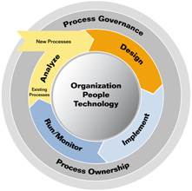
Project management
Quality Assurance
Result
Introduction
Group
Project
Business context
Plan
Development process
Requirement
Design
Implement
Testing
Demo
Q&A

Slide 7
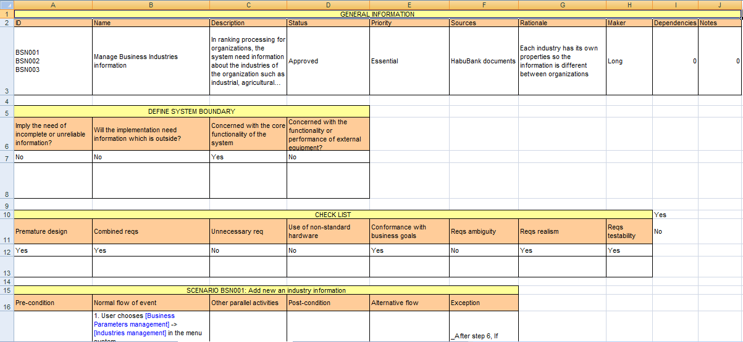
Project management
Quality Assurance
Result
Introduction
Group
Template
Project
Business context
Plan
Development process
Requirement
Design
Implement
Testing
Demo
Q&A

Slide 8
Project management
Quality Assurance
Result
Introduction
Review action:
Review within sub-team.
Cross-review of two sub-team
Customers clarification.
Group
Project
Business context
Plan
Development process
Requirement
Design
Implement
Testing
Demo
Q&A

Slide 9
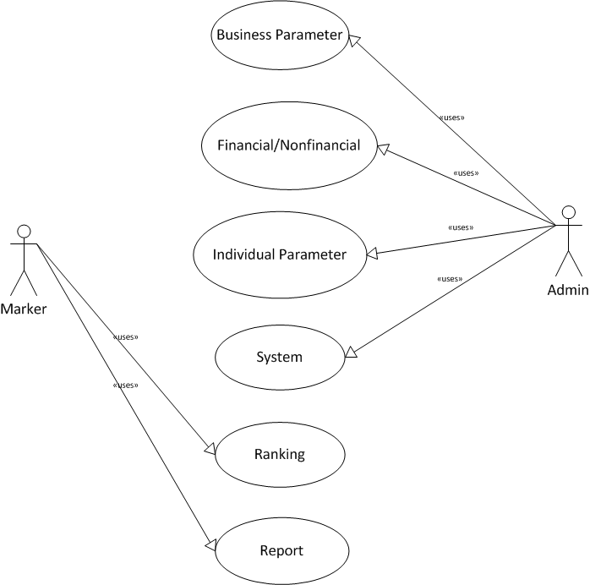
Project management
Quality Assurance
Result
Introduction
Result:
FUNCTIONAL REQUIREMENT
Use cases:
22 BSN use cases
33 INV use cases
14 NFI use cases
9 FI use cases
24 SYS use cases
17 RNK Use cases
2 RPT use cases
Group
Project
Business context
Plan
Development process
Requirement
Design
Implement
Testing
Demo
Q&A

Slide 10
Project management
Quality Assurance
Result
Introduction
NON FUNCTIONAL
Reliability
Group
Project
Business context
ID | Metric | Requirement
REL001 | POFOD (Probability of failure on demand) | 0.002 In 500 of service requests may result 1 failure on demand
REL002 | ROCOF (Rate of failure occurrence) | 0.005 In 1000 operational time units, there are 5 failures likely to occur
REL003 | MTTF (Mean time to failure) | 720(h) Mean time between two successive failures is 720h
REL004 | AVAIL (Availability) | 0.950 In 1000 hours of operation, the system must be available for at least 950h
REL005 | MTTR (Mean time to repair) | 24(h) The system is allowed 24h to be out of operation after it has failed
REL006 | DR Defect rate | 1 bug / KLOG (thousand lines of code)
Plan
Development process
Requirement
Design
Implement
Testing
Demo
Q&A

Slide 11
Project management
Quality Assurance
Result
Introduction
NON FUNCTIONAL
Security
Group
Project
Business context
ID | Type
SEC001 | Identification
SEC002 | Authentication
SEC003 | Authorization
SEC004 | Privacy
SEC005 | Immunity
SEC006 | Integrity
Plan
Development process
Requirement
Design
Implement
Testing
Demo
Q&A

Slide 12
Project management
Quality Assurance
Result
Introduction
NON FUNCTIONAL
Portability
Group
Project
Business context
ID | Type | Requirement
POR001 | Program portability | The system must be deployed as an Extranet Website and required to be run successfully on Internet Explorer 7 or upper and other popular browsers such as Firefox and Google Chrome
POR002 | Data portability | The data of the system must be stored using SQL Server Express 2005 or Oracle database
POR003 | End-user portability | The system is required to have the same look and feel across different browsers. All are displayed according to the standard of Website user interface design: The form of index pages will list all the record, and there is a link to the add, edit and remove page. All the button of saving changes or adding will be put at the bottom of the textboxes. When there are some errors occurred, display red message to the users and require them to do again (if possible). After successfully changing the data, display notification to users. All pages of the application will have the same menu and users can access to functionalities of the system from here.
Plan
Development process
Requirement
Design
Implement
Testing
Demo
Q&A

Slide 13
Project management
Quality Assurance
Result
Introduction
NON FUNCTIONAL
Performance
Group
Project
Business context
ID | Type | Requirement
PER001 | Response time | The average time to response for a transaction when managing parameters is 2s and the maximum is 5s. The average time to response for a transaction when ranking for customers is 3s and the maximum is 8s
PER002 | Capacity | The system can accommodate for a maximum number of 1000 users at different locations
Plan
Development process
Requirement
Design
Implement
Testing
Demo
Q&A

Slide 14
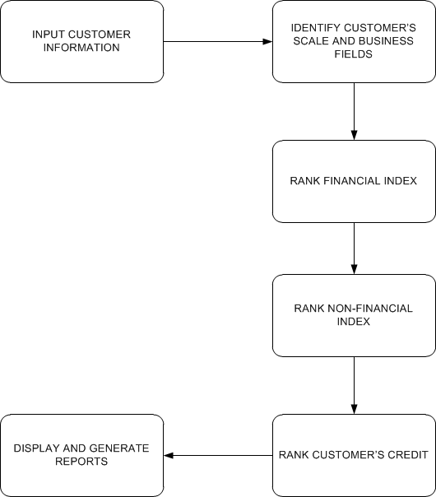
Project management
Quality Assurance
Result
Introduction
DOMAIN REQUIREMENT
Group
Project
Business context
Plan
Development process
Requirement
Design
Implement
Testing
Demo
Q&A

Slide 15
Project management
Quality Assurance
Result
Introduction
BSN: Business parameter management:
Manage Parameter for ranking business Industry
Industry
Scale
Business Types
… etc
NFI, FI: manage index for Financial and non-financial index
Parent and child index
Numeric and character index
Proportion
Score.
Group
Project
Business context
Plan
Development process
Requirement
Design
Implement
Testing
Demo
Q&A

Slide 16
Project management
Quality Assurance
Result
Introduction
INV: Individual parameter management:
Manage Parameter for ranking individual
Basic and collateral index
Loan term, purposes etc…
Group
Project
Business context
Plan
Development process
Requirement
Design
Implement
Testing
Demo
Q&A

Slide 17
Project management
Quality Assurance
Result
Introduction
INV: Individual parameter management:
Manage Parameter for ranking individual
Basic and collateral index
Loan term, purposes etc…
Group
Project
Business context
Plan
Development process
Requirement
Design
Implement
Testing
Demo
Q&A

Slide 18
Project management
Quality Assurance
Result
Introduction
Ranking for customers.
Business customers:
General Info
Scale
Financial
Non-Financial
Ranking
Individual customers
General Info
Basic Index
Collateral Index
Ranking
Group
Project
Business context
Plan
Development process
Requirement
Design
Implement
Testing
Demo
Q&A

Slide 19
Project management
Quality Assurance
Result
Introduction
RPT: Extract Reports.
Group
Project
Business context
Plan
Development process
Requirement
Design
Implement
Testing
Demo
Q&A

Slide 20
Project management
Quality Assurance
Result
Introduction
Chính
Cho nhiều hình ảnh
Bao gồm cả DB và DDD
Model trực quan
DB: thỏa mãn chức năng của chương trình và phải kế thừa được dữ liệu, đảm bảo chuẩn 3
Architecture design: 3 tiers, middle tier: MVC
Cần đảm bảo chính xác, có khả năng cao sẽ bị thầy Trí bắt bẻ
Component diagram, modules
DDD: show ảnh
Group
Project
Business context
Plan
Development process
Requirement
Design
Implement
Testing
Demo
Q&A

Slide 21
Project management
Quality Assurance
Result
Introduction
Giang + Chính + Ly
Giang
Cách làm việc
Ly:
Ranking
Chính:
Mining, algorithms
Group
Project
Business context
Plan
Development process
Requirement
Design
Implement
Testing
Demo
Q&A

Slide 22
Project management
Quality Assurance
Result
Introduction
Ranking
Group
Project
Business context
Plan
Development process
Requirement
Design
Implement
Testing
Demo
Q&A

Slide 23
Project management
Quality Assurance
Result
Introduction
Thảokun + Giang, 12-15m
Cách làm việc (log bug lên google code, assign, prioroty…)
TC: viết ngay sau requirement
Thống kê
Template
Group
Project
Business context
Plan
Development process
Requirement
Design
Implement
Testing
Demo
Q&A

Slide 24
Project management
Quality Assurance
Result
Introduction
Long – 10m
Riêng phần mining: CHính
Group
Project
Business context
Plan
Development process
Requirement
Design
Implement
Testing
Demo
Q&A

Slide 25
Project management
Quality Assurance
Result
Introduction
Ro
Group
Project
Business context
Plan
Development process
Requirement
Design
Implement
Testing
Demo
Q&A

Slide 26
Project management
Quality Assurance
Result
Introduction
Ro
Group
Project
Business context
Plan
Development process
Requirement
Design
Implement
Testing
Demo
Q&A

Slide 27
Hot Tip
How do I incorporate my logo to a slide that will apply to all the other slides?
On the [View] menu, point to [Master], and then click [Slide Master] or [Notes Master]. Change images to the one you like, then it will apply to all the other slides.

Slide 28
Diagram
Title
Add your text
ThemeGallery is a Design Digital Content & Contents mall developed by Guild Design Inc.
ThemeGallery is a Design Digital Content & Contents mall developed by Guild Design Inc.

Slide 29
Cycle Diagram
Add Your Text
Text
Text
Text
Cycle name
Text
Text

Slide 30
Diagram
Text
Add Your
Title Text
Text 1
Text 2
Text 3
Text 4
Text 5
Add Your
Title Text
Text 1
Text 2
Text 3
Text 4
Text 5
Text
Text
Text
Text

Slide 31
Diagram
Text
Text
Concept
Text
Text
Text
Text
Add Your Text

Slide 32
Diagram
Add Your Text
Add Your Text
Add Your Text
Add Your Text
Add Your Text
Add Your Text
Add Your Text
Add Your Text

Slide 33
Diagram
Add Your Text
Add Your Text
Add Your
Title
Add Your Text

Slide 34
Diagram
Text
Text
Text
ThemeGallery is a Design Digital Content & Contents mall developed by Guild Design Inc.
ThemeGallery is a Design Digital Content & Contents mall developed by Guild Design Inc.
ThemeGallery is a Design Digital Content & Contents mall developed by Guild Design Inc.

Slide 35
Diagram
Text
Text
Text
Add Your Title
Text

Slide 36
Cycle Diagram
Add Your Text
B
Add Your Text
A
C
Add Your Text
Concept
E
D
Add Your Text
Add Your Text

Slide 37
Diagram
1
2
3
ThemeGallery is a Design Digital Content & Contents mall developed by Guild Design Inc.
ThemeGallery is a Design Digital Content & Contents mall developed by Guild Design Inc.
ThemeGallery is a Design Digital Content & Contents mall developed by Guild Design Inc.

Slide 38
Diagram
2001
2002
2003
2004
Your Text
Your Text
Your Text
Your Text
Your Text
Your Text
Your Text
Your Text

Slide 39
Diagram
Add Your Text
Add Your Text
Add Your Text
Add Your Text

Slide 40
Block Diagram
TEXT
TEXT
TEXT
TEXT
TEXT
TEXT
TEXT
TEXT

Slide 41
Table
 | Title | Title | Title | Title | Title
Title | O | O | O | O | O
Title | O | O | O | O | O
Title | O | O | O | O | O
Title | O | O | O | O | O
Title | O | O | O | O | O
Title | O | X | O | X | O

Slide 42
3-D Pie Chart
Text2
Text3
Text1
Text4
Text5

Slide 43
Block Diagram
Add Your Text
Add Your Text
concept
Concept
Concept
Concept

Slide 44
Thank You !
www.themegallery.com

